Slide 1

ISO : 45001 One Volts Service Co.,Ltd Safety Performance
31 August 2023

Slide 2
Monthly Performance Update
5.3 Corporate Safety Division
( Safety Power Plant )
One Volts Service Co.,Ltd.

Slide 3
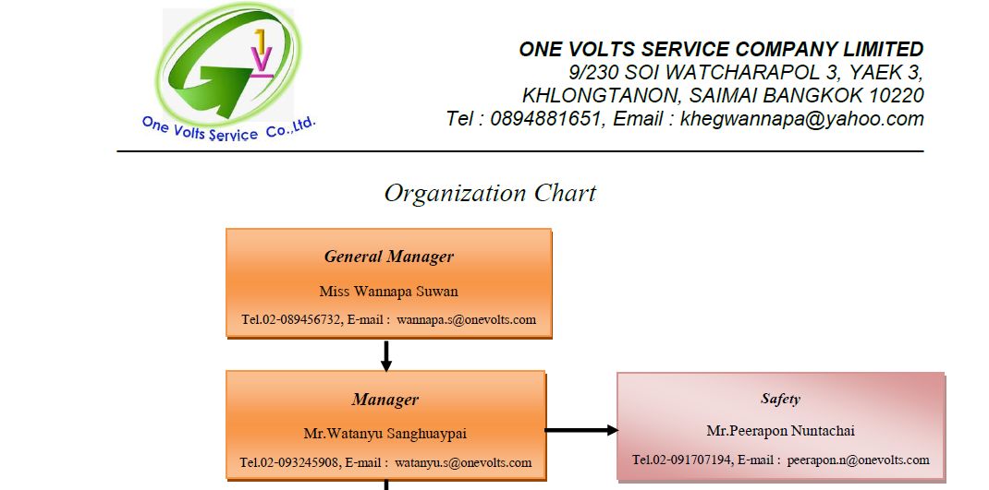
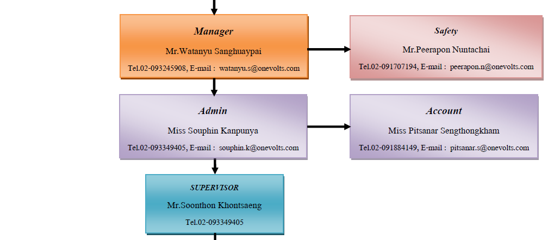
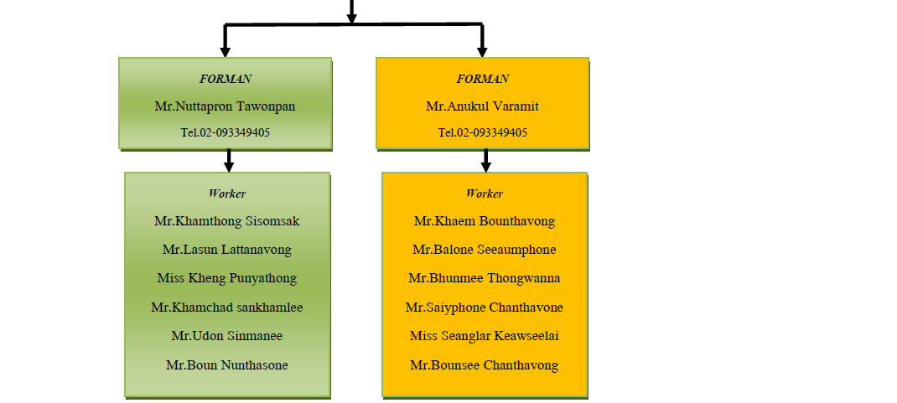
Organization Chart Site Office in Hongsa Project

Slide 4
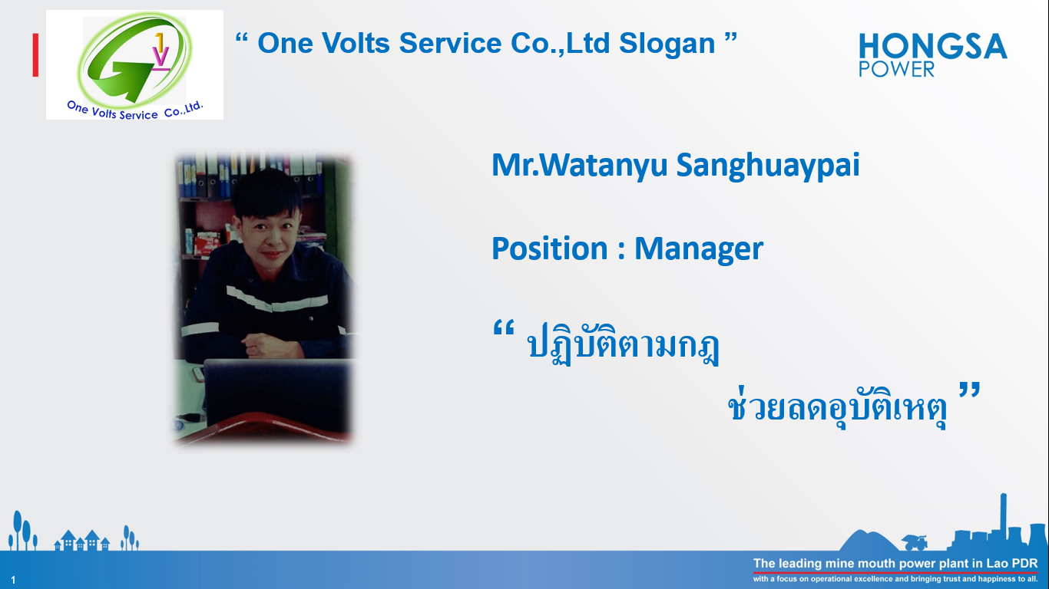
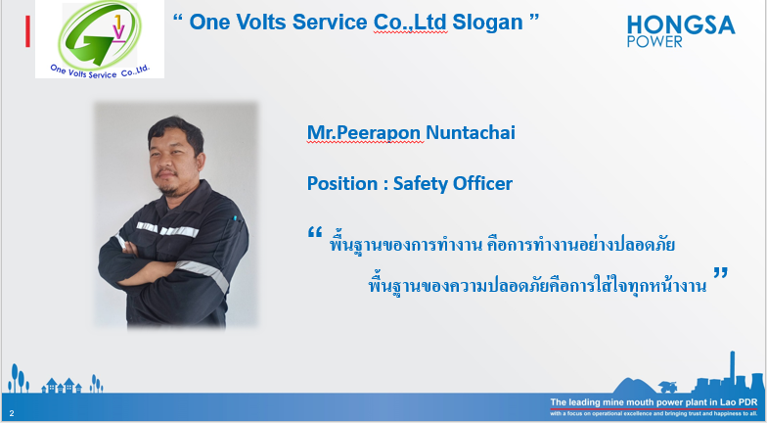
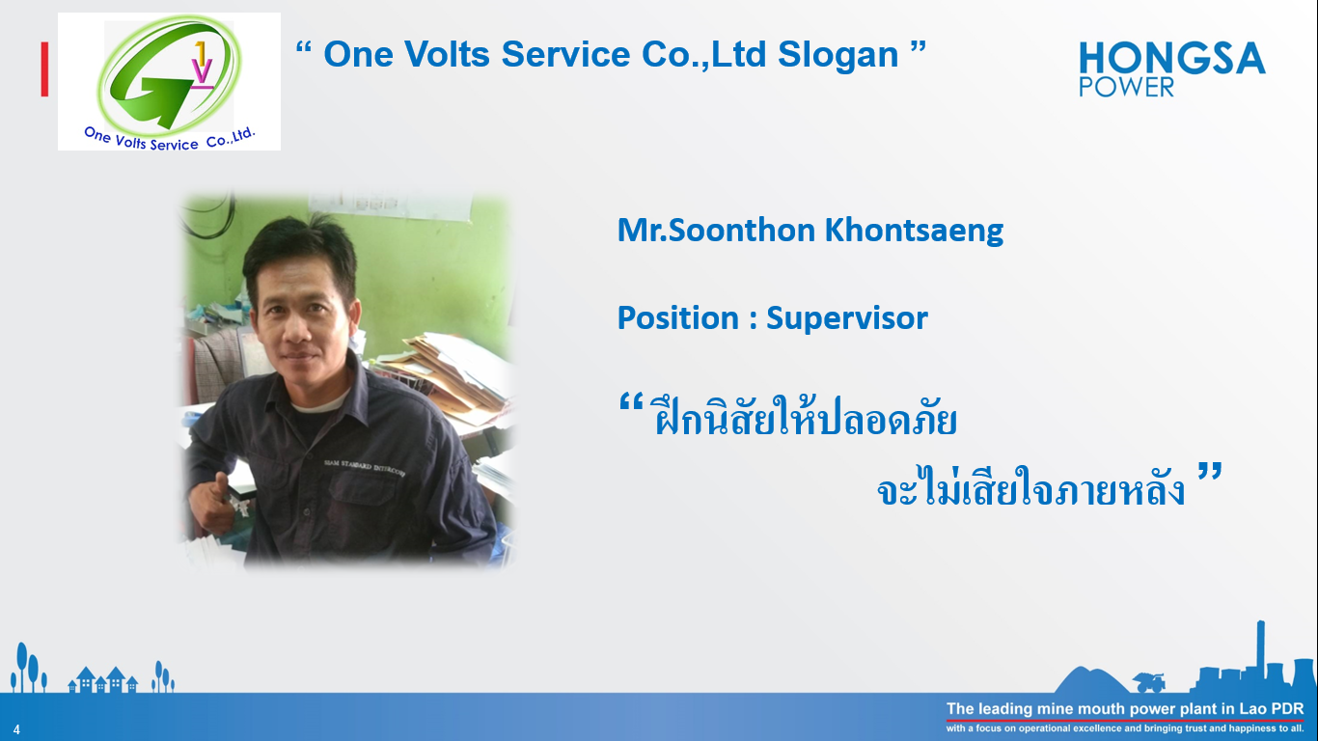
SAFETY SLOGAN

Slide 5
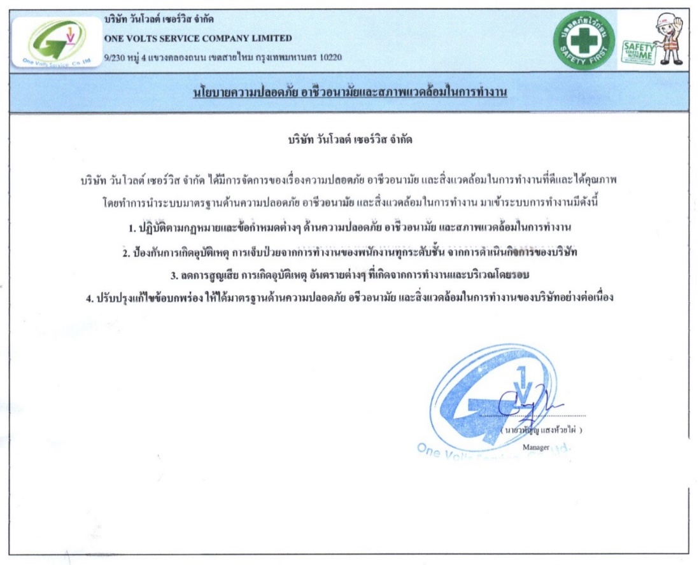
นโยบายด้านความปลอดภัย

Slide 6
POWER PLANT SAFETY PERFORMANCE YEAR 2023
One Volts Service Co.,Ltd.
Man-Hour /Month | Jan | Feb | Mar | Apr | May | Jun | July | Aug | Sep | Oct | Nov | Dec | Total
Manpower | 42 | 44 | 44 | 43 | 41 | 41 | 48 | 49 |  |  |  |  | -
Working Hours | 7,680 | 8,048 | 8,760 | 8,256 | 7,872 | 7,872 | 10,752 | 12,152 |  |  |  |  | 71,392
We are here
Working Hours W/H LTI Target 2023
Power Plant
: 15.0 Million (5 Feb 21 - 25 Dec 2023 )
Working Hours W/H LTI Actual
Working Hours in August ’23 : 12,152 Hours
Total Working Hours without LTI Y2023 : 71,392 Hours
Best Record W/H LTI : 146,592 Hours
(26 Dec 21 – 25 August 23)

Slide 7
One Volts Service Co.,Ltd ACCIDENT PYRAMID 2022
POWER PLANT
ACCIDENT
PYRAMID
YEAR TO DATE Y2023
2023
2023
(26 DECEMBER 2022 – 25 July 2023)
HPC All
MINING
POWER PLANT
SUPPORT
 |  | 0
 |  | 0
 |  | 0
 |  | 0 (0), (0), (0)
 |  | 0 OVS (0), (0)
1
0
Fatality
10
0
LTI
30
0
Medical Treatment
300
0
Property Damage (0), First Aid (0), Near-Miss (0)
3000
17
Unsafe Condition (13) or at-risk situation, Unsafe Act (2)

Slide 8
One Volts Service Co.,Ltd ACCIDENT in December 2022
No Accident of this Month

Slide 9

IAMCCC Performance to Achieve “0” LTI Case
I
Implement Effectiveness
C
Commitment
Safety sign layout in power plant area (In the installation phase)
Review and analyze risk assessment to complete all activity and section
Set up report plan and follow up and review data from contractor for ISO45001 together with advise contractor about topic as required
Review SPR 9 report, JSA 33 reported And PWRA 45 reported.
Set up safety officer organization in executive and supervisory level for power plant
Safety slogan & safety key message in the meeting
Working hours without LTI target:
12,000,000 hours (Continuous) / 8,100,000 hours (Year 2022)
C
Communication
COVID-19 Control measures in plant.
Safety talk in small group of each contractor before starting a job
Weekly SHE contractor meeting 18 times
Promote Stop and Thinks card and steel poster 10 points.
A
Awareness
Contractor participate to report UA, UC and near miss
Following submission of House keeping everyday and weekly activity. activity in power plant
C
Competency
M
Mindset
Update training record of HPC power plant
Safety officer of contractor checked wearing PPE of team before entry of power plant and everyone cooperate very well
Safety role model
Weekly Exercise fire fighting team
Refreshment General safety for contractor 7/15 Class

Slide 10
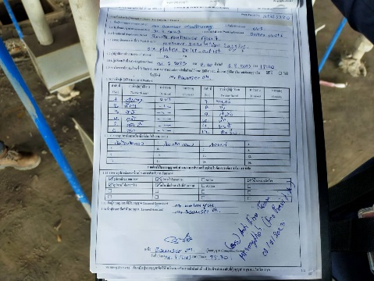
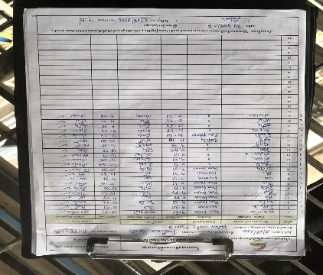
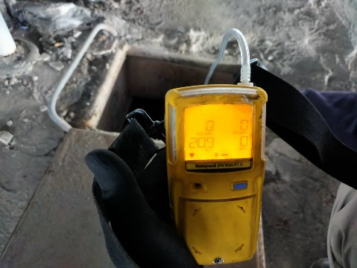
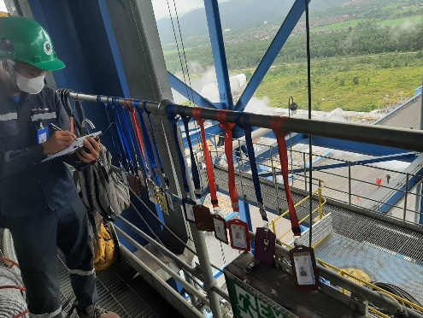
IAMCCC Performance to Achieve “0” LTI Case
staff body temperature measurement
I
Implement Effectiveness
- Safety sign layout in power plant area (In the installation phase)
- Review and analyze risk assessment to complete all activity and section
- Review SPR report, JSA reported And PWRA reported.
- Set up safety officer organization in executive and supervisory level for power plant

Slide 11
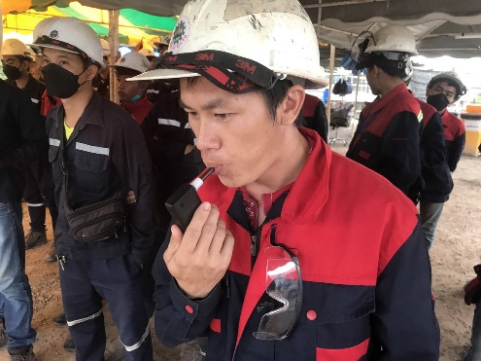
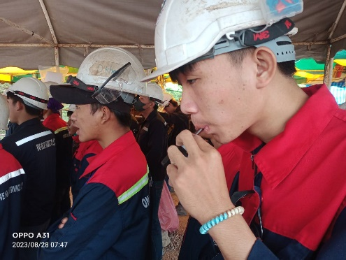
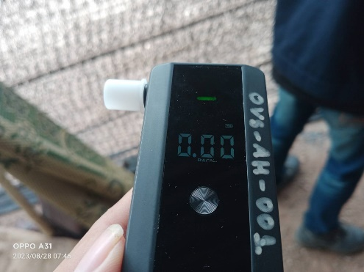
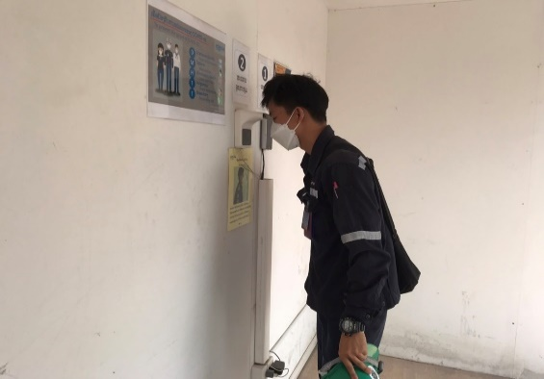
IAMCCC Performance to Achieve “0” LTI Case
staff body temperature measurement
A
Awareness
Staff body temperature measurement
Staff Alcohol measurement
Strengthen Safety Performance

Slide 12

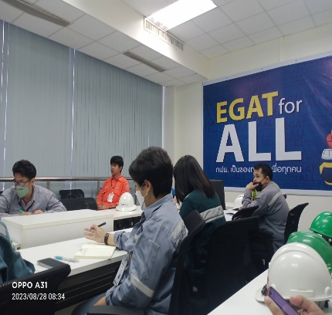
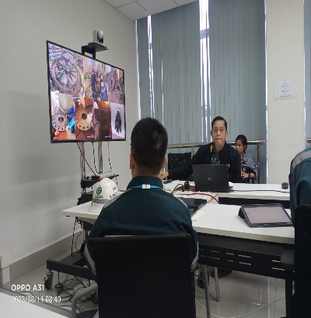
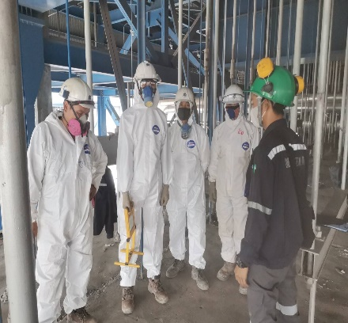
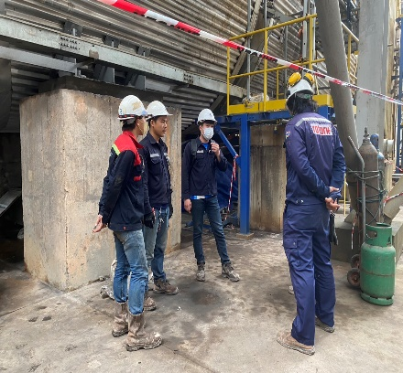
IAMCCC Performance to Achieve “0” LTI Case
C
Communication
- Safety talk in small group of each staffs before starting a job
- Sharing SHES MOMENT OF July ’2023 (How to protect yourself during earthquake) to staffs.
- Attend Safety Daily meeting

Slide 13
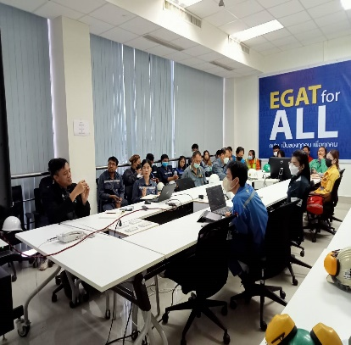
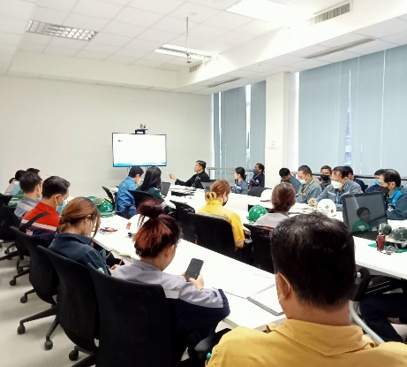
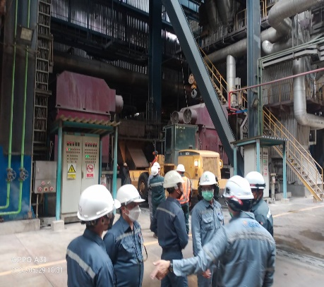
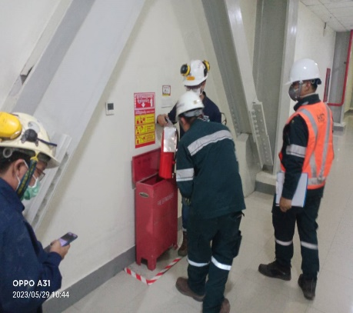
IAMCCC Performance to Achieve “0” LTI Case
M
Mindset
Attend SHE-Contractor Weekly
Attend Bi-Weekly Walk Down Power Plan Area

Slide 14
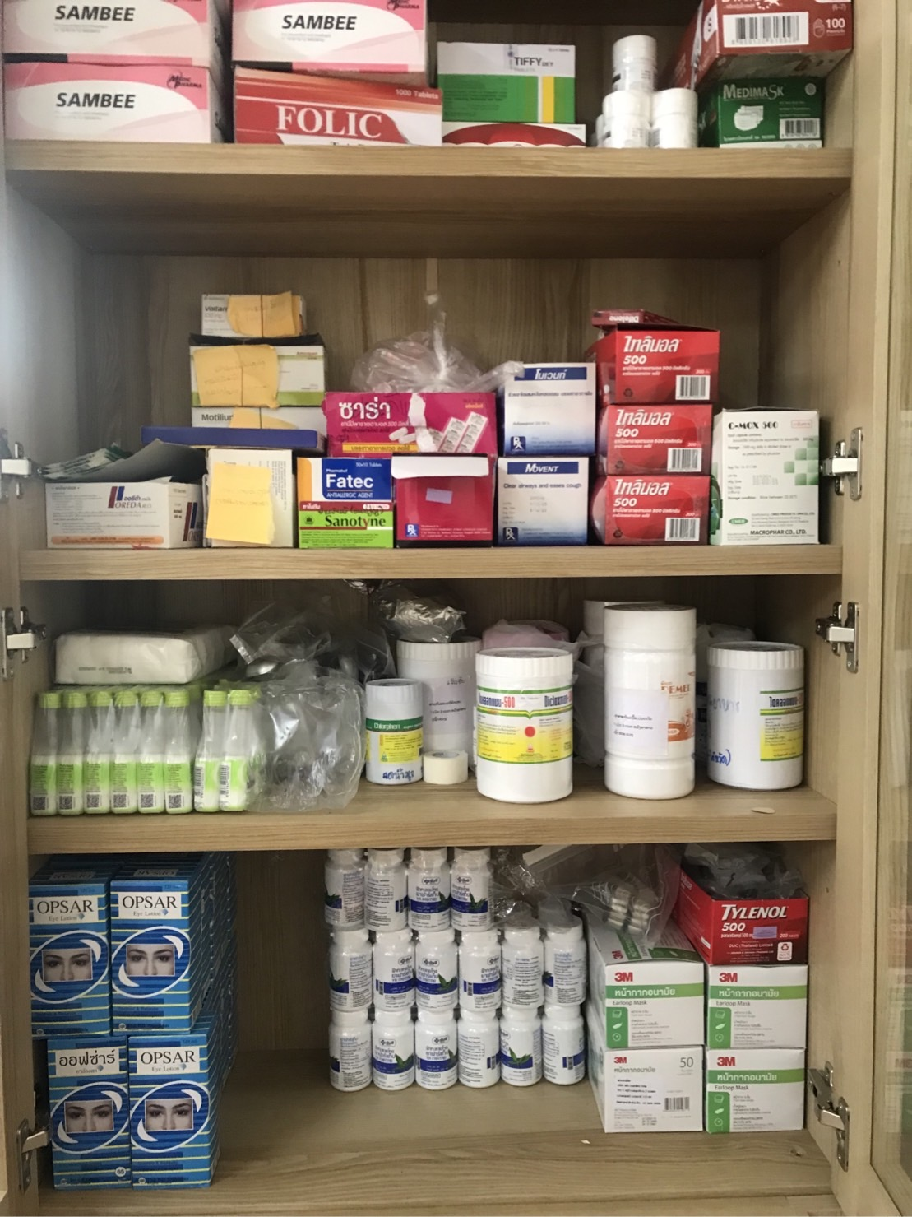
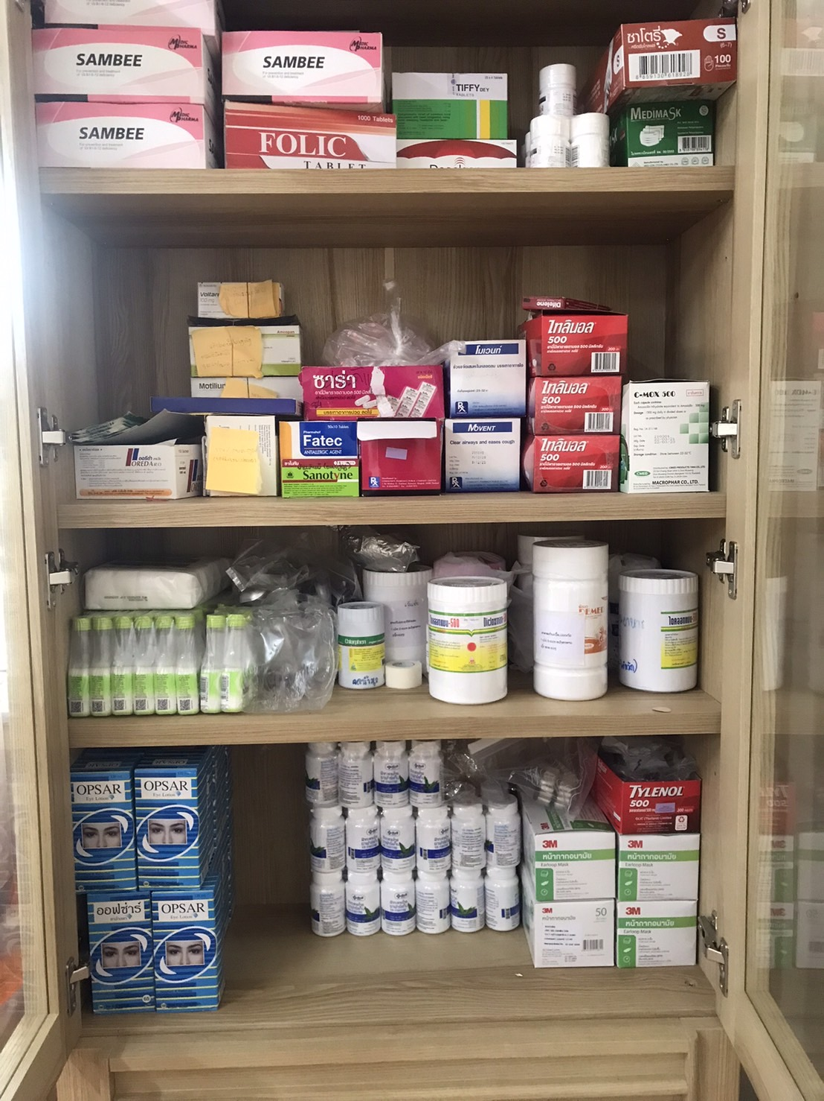
IAMCCC Performance to Achieve “0” LTI Case
A
Awareness
Primary Therapy
First Aid

Slide 15
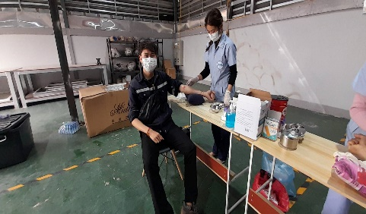
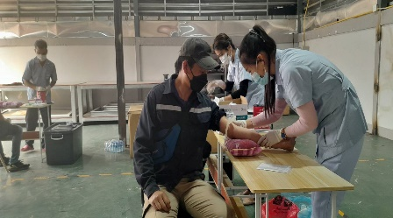
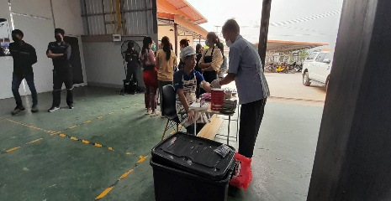
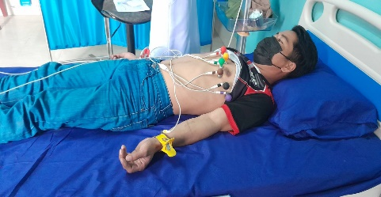
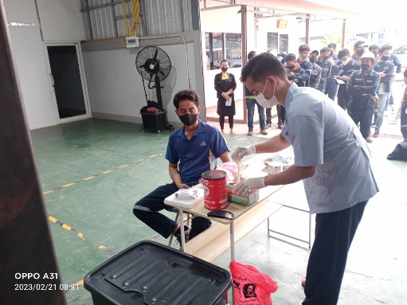
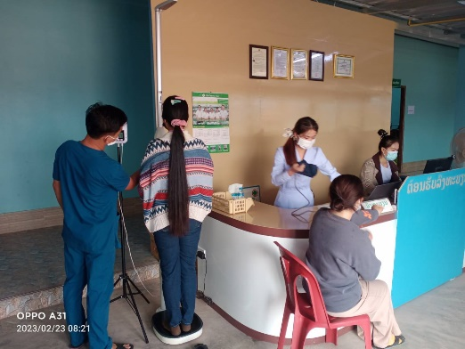
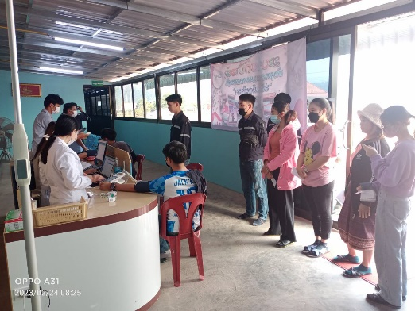
IAMCCC Performance to Achieve “0” LTI Case
A
Awareness
Annual Health Check.

Slide 16
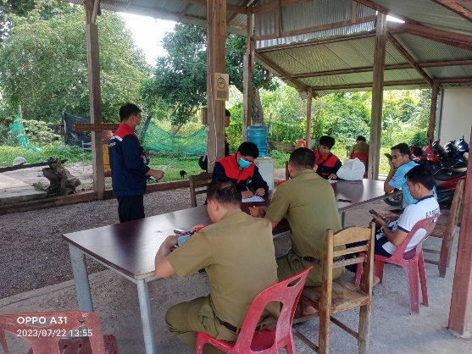
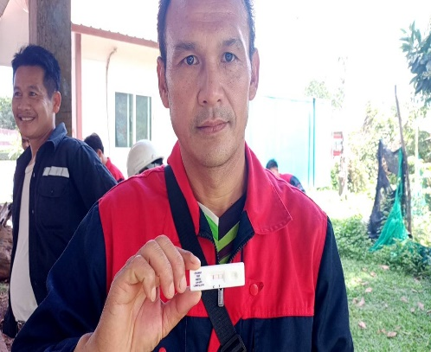
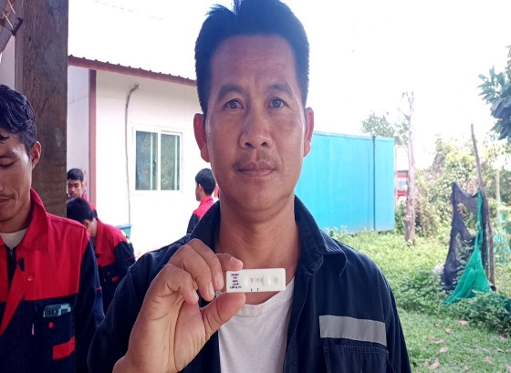
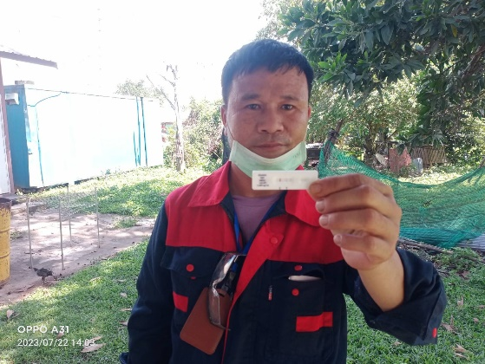
IAMCCC Performance to Achieve “0” LTI Case
staff body temperature measurement
A
Awareness
Strengthen Safety Performance
Monthly Drug Testing Course

Slide 17
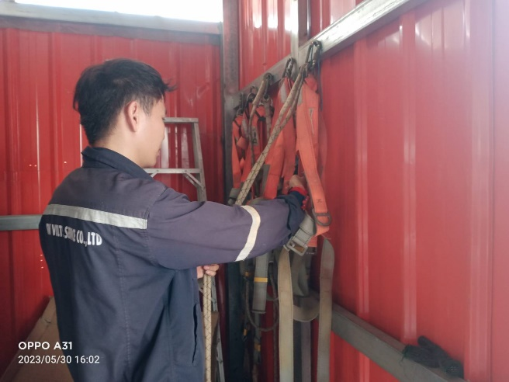
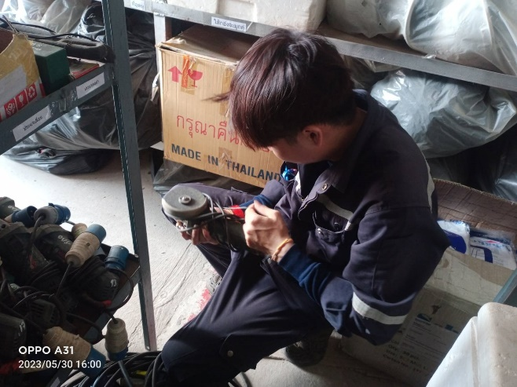
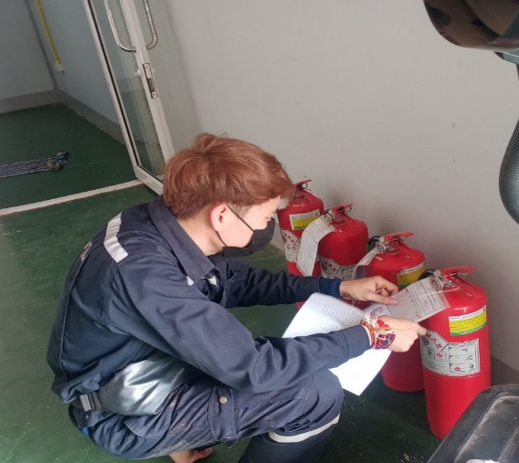
IAMCCC Performance to Achieve “0” LTI Case
staff body temperature measurement
A
Awareness
- Contractor participate to report UA, UC and near miss
- Monthly Inspection of Electrical Equipment
- Fire extinguisher checking

Slide 18
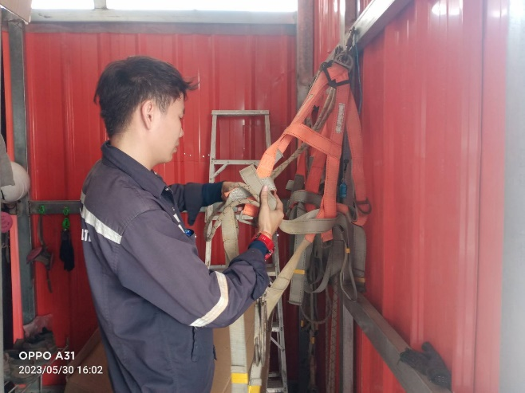
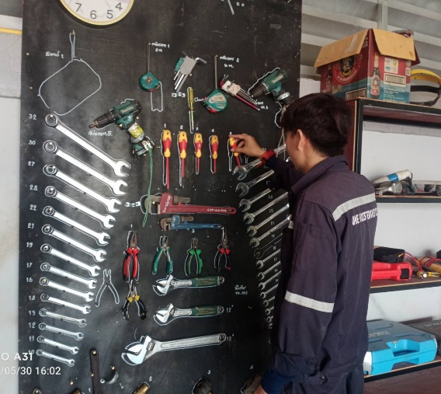
IAMCCC Performance to Achieve “0” LTI Case
staff body temperature measurement
A
Awareness
Monthly Inspection of tool Equipment
- Monthly Inspection of Safety Full body Harness Equipment

Slide 19
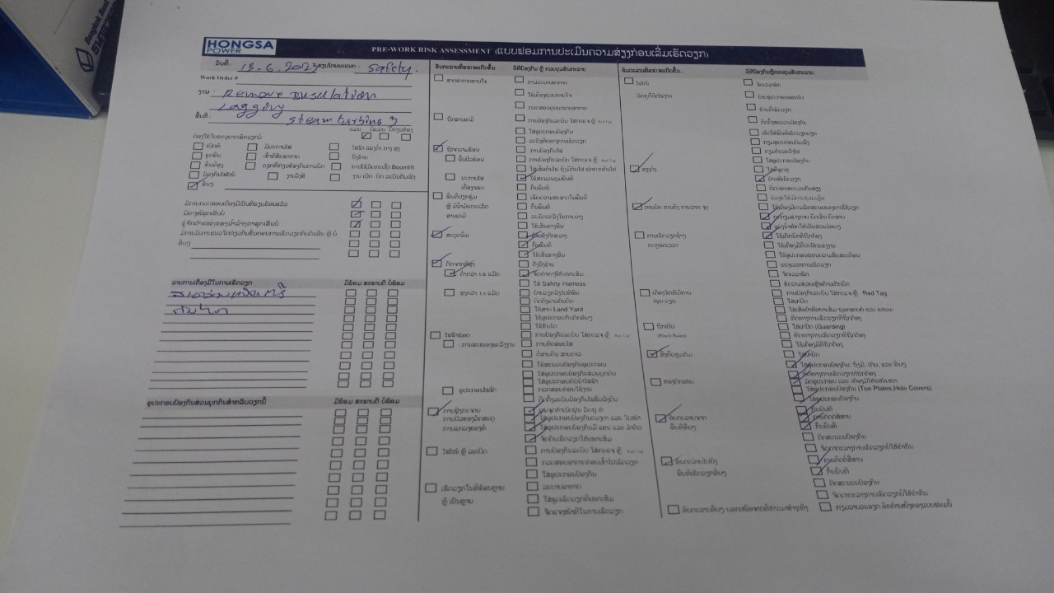
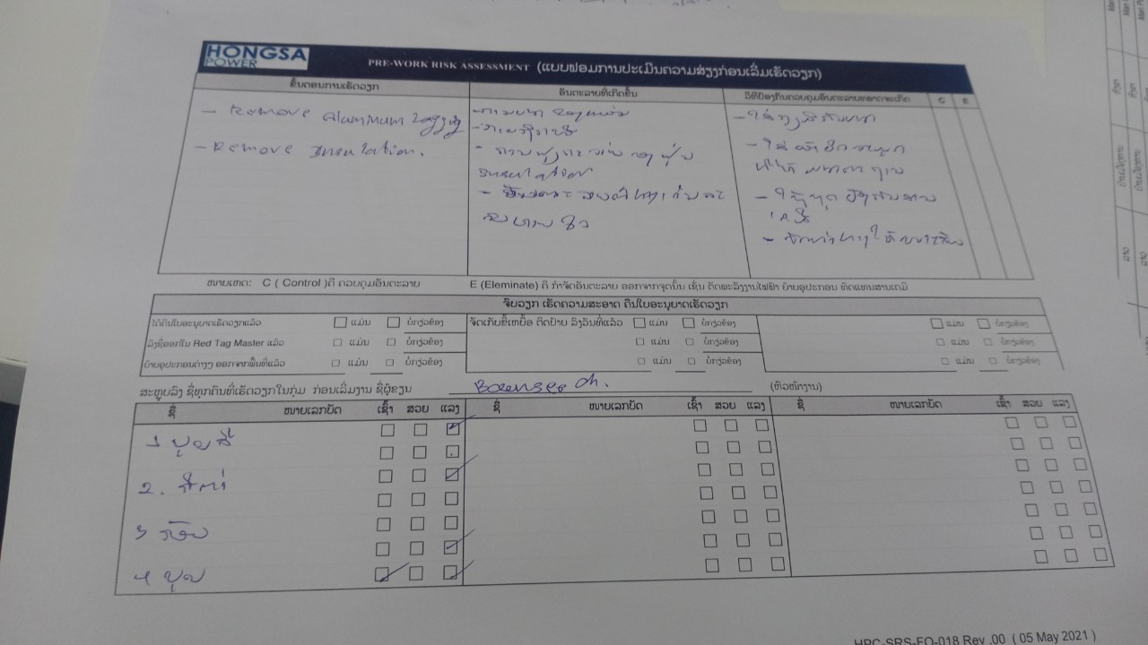
IAMCCC Performance to Achieve “0” LTI Case
staff body temperature measurement
A
Awareness
Contractor participate to report UA, UC and near miss
Assess the risks before starting work Using PWRA

Slide 20
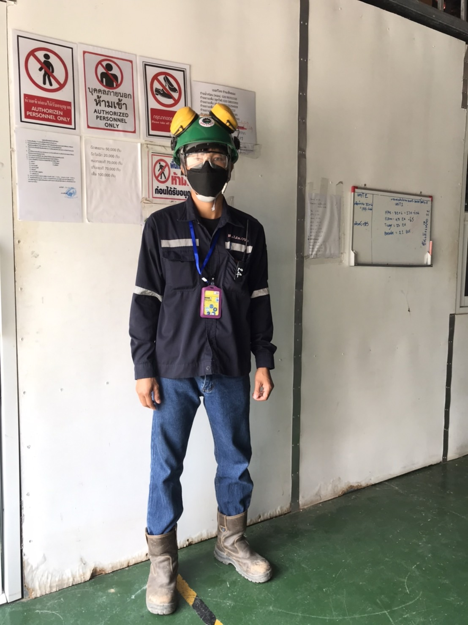
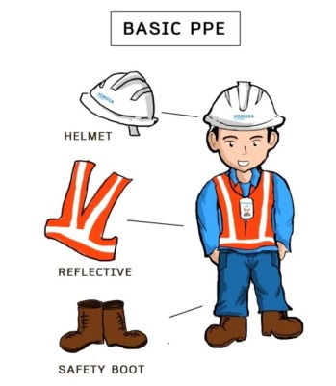
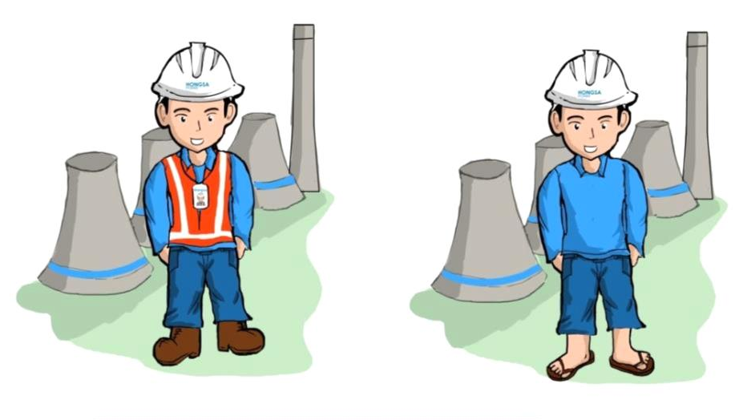


IAMCCC Performance to Achieve “0” LTI Case
M
Mindset
Safety officer of contractor checked wearing PPE of team before entry of power plant and everyone cooperate very well
Safety role model

Slide 21
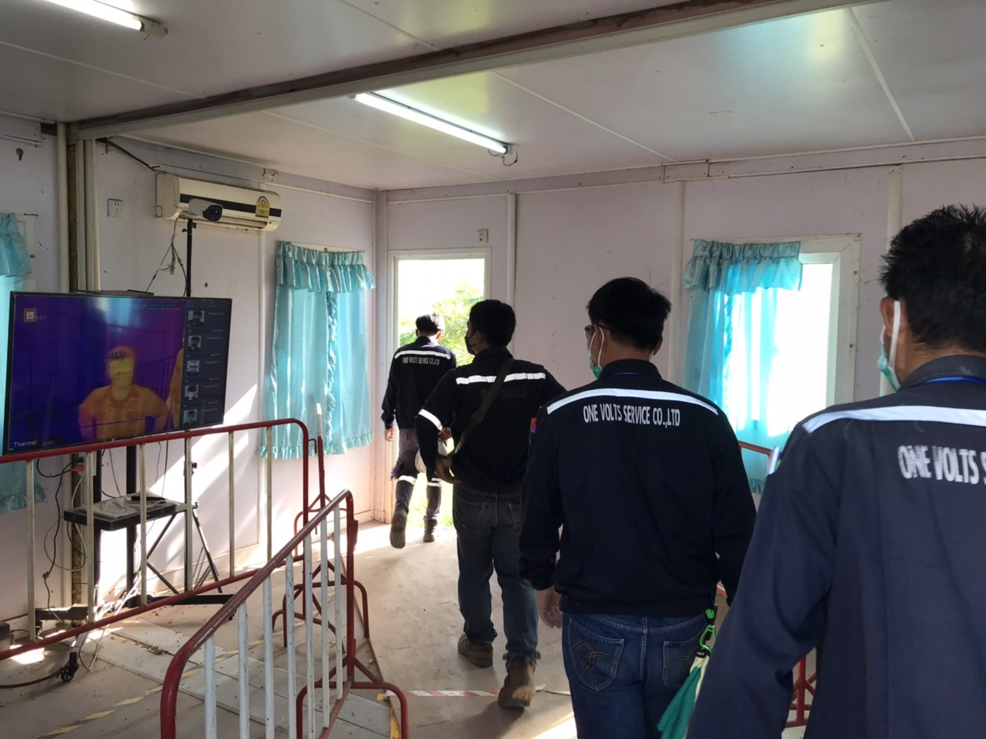
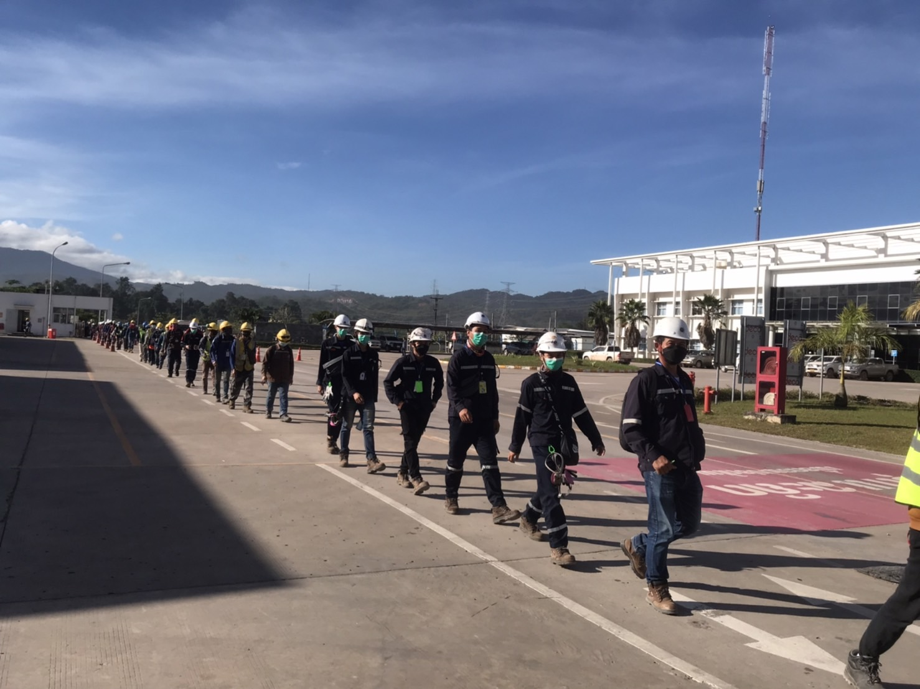
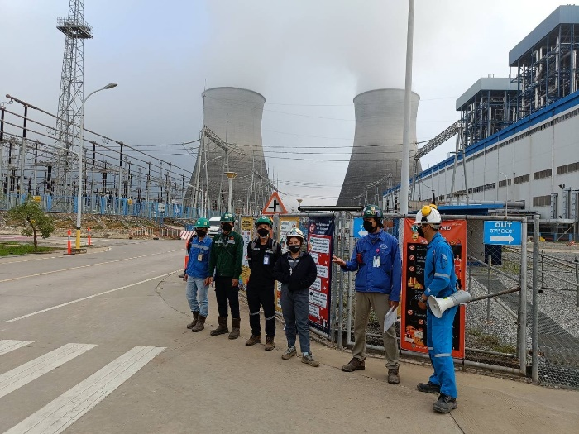
IAMCCC Performance to Achieve “0” LTI Case
C
Communication
COVID-19 Control measures - social distancing
Safety talk in small group of each staffs before starting a job
Sharing SHES MOMENT OF july’2023 (How to protect yourself during earthquake) to staffs.
Attend Weekly SHE contractor meeting

Slide 22
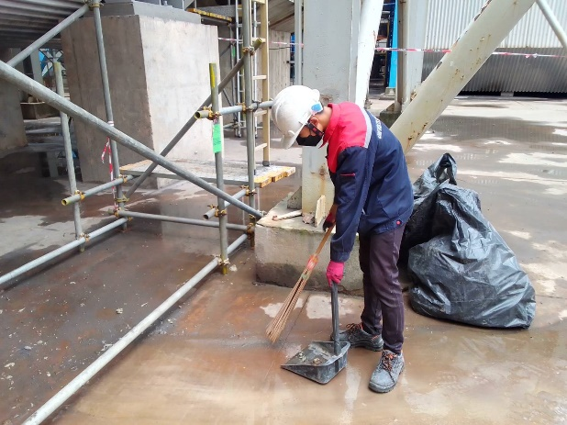


IAMCCC Performance to Achieve “0” LTI Case
A
Awareness
- Contractor participate to report UA, UC and near miss
- Following submission of House keeping everyday and weekly activity. activity in power plant

Slide 23


IAMCCC Performance to Achieve “0” LTI Case
C
Competency
Update training record of One Volts Service Co.,Ltd
General safety training,Report Problems,Obstacles and Fix various Obstacles
Attend the Psychosocial Risk Assessment training

Slide 24
Difficulty and area of concerned
Key Progress | Difficulties & Concerns | Resolution | Target Date | PIC*-
- Insulation Lagging and Expension Joint. | Dust Particles and Glass fiber fragments (Respiratory hazards). | wearing 3M mask while working. Refreshment of work procedure to staffs. House keeping everyday and weekly activity. watering around working area. | Continual communication 2023 | One Volts Service Co.,Ltd Safety

Slide 25
One Volts Service Co.,Ltd Thank You

